Slide 1



By-Shrishti Jain

Slide 2


1.Select the target.
2.Scan for active devices.
3.Look for open ports.
4.Check the services.
5.Find the versions of running open
services.
6.Find the O.S.
7.Find security solutions.
8.Select correct type of network
scanning.

Slide 3
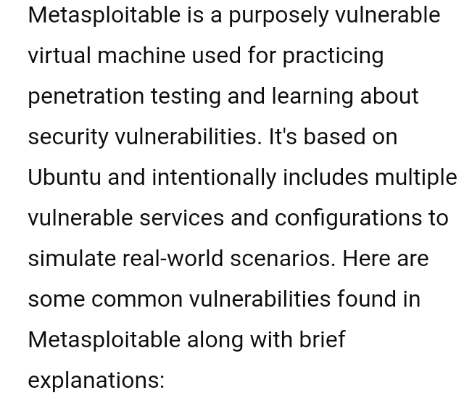

Slide 4
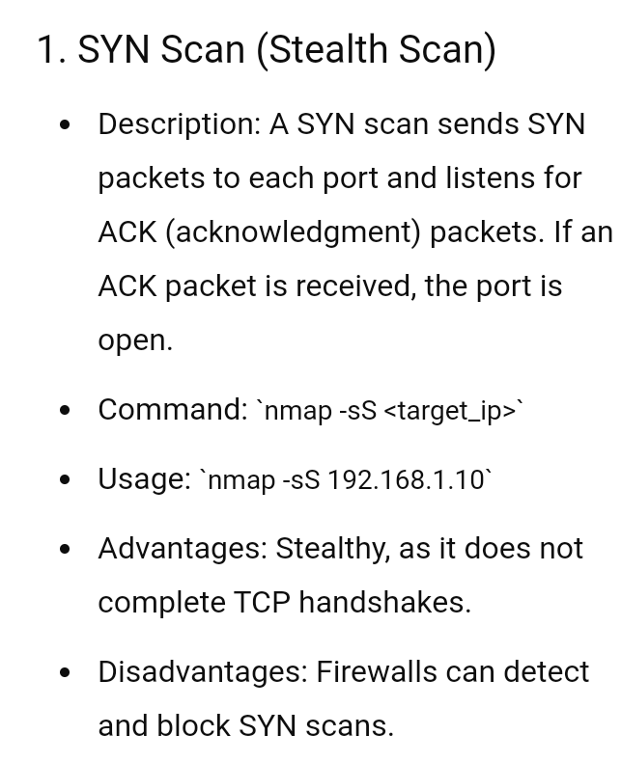

Slide 5
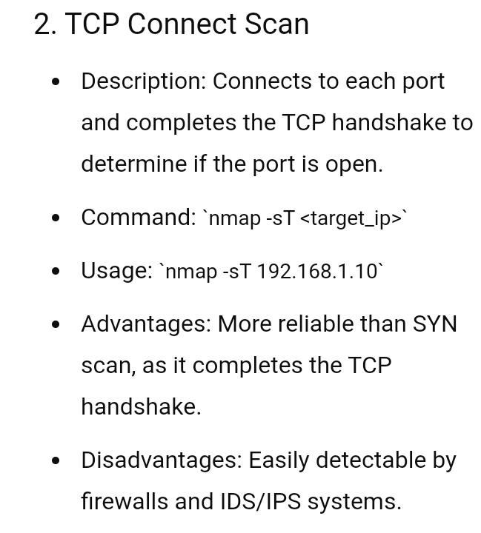

Slide 6
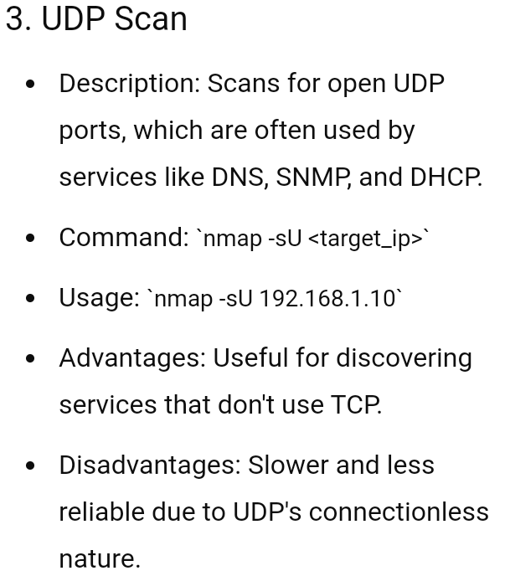

Slide 7
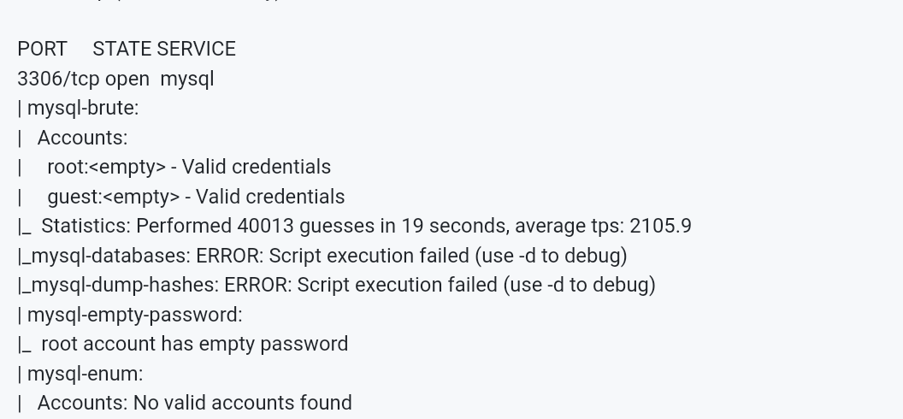

Slide 8


Slide 9
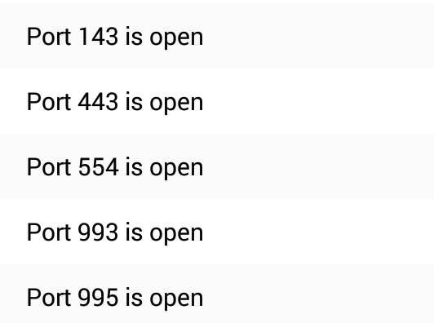
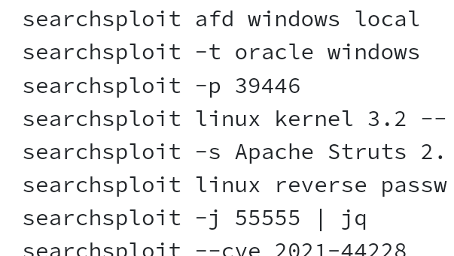

Slide 10


